Slide 1

INSULYN AI
Type 2 Diabetes Risk Prediction Agent
BY GROUP 1

Slide 2

CONTENT
01
02
Team introduction
Business Understanding
03
04
Data Understanding
EDA
05
06
Modelling
Web application deployment
07
08
Recommendations
Expansion Opportunities

Slide 3

Team Introduction
Our Team
Frankline Ondieki
Pacificah Kwamboka Asamba
Hellen Diana Macharia
Mathews Odongo
Nightingale Jeptoo
Tinah Ngei

Slide 4

BUSINESS UNDERSTANDING
PROBLEM STATEMENT
Diabetes is a growing global health crisis. Many cases go undiagnosed until advanced stages. Predictive analytics can support preventive care and reduce complications.
CONTEXT:
In Africa: 24M adults live with diabetes (2021), projected to rise 129% by 2045, the fastest growth worldwide.
Over half (54%) remain undiagnosed, causing about 416K deaths yearly.
In Kenya: 3.3% adult prevalence (~1.3M people), rising to 12% in cities; costs ≈ KES 35B annually in healthcare costs with 45% unaware of their condition.

Slide 5
Type 2 Diabetes Risk Prediction Goal
Early Diabetes Detection Objective
1
Our project aims to identify individuals at high risk of developing diabetes before clinical symptoms appear, enabling timely preventive interventions.
AI-Powered Preventive Healthcare
2
Leveraging machine learning to analyze health indicators and predict diabetes risk, transforming reactive treatment into proactive prevention strategies.
3
Reducing Healthcare Burden
Early identification of at-risk patients helps decrease hospitalization rates, lower treatment costs, and improve quality of life through preventive care.

Slide 6
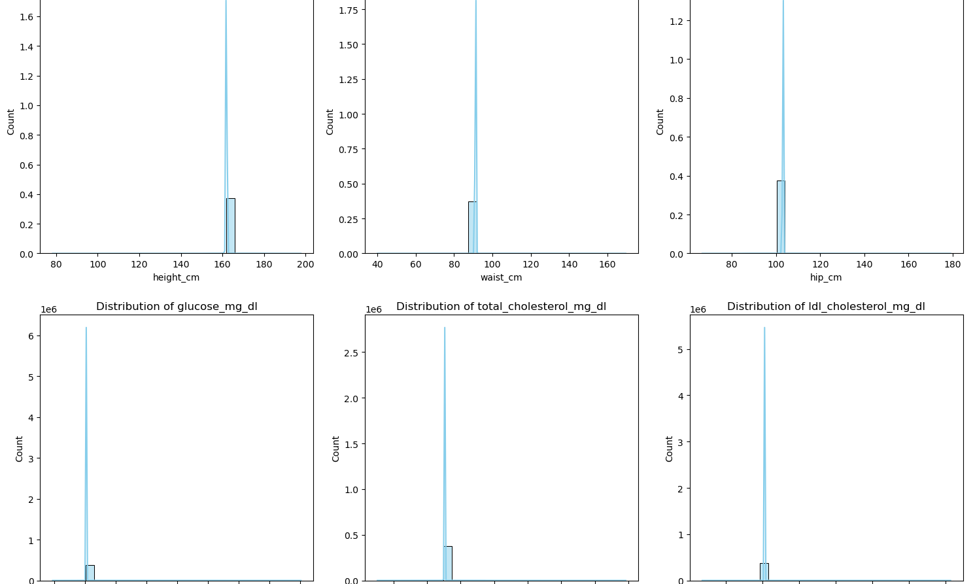
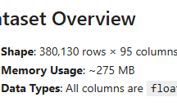
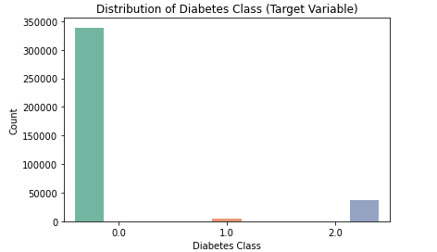
Dataset Characteristics
01
03
Dataset Overview
Class Balance
The dataset contains 380,130 rows and 95 columns (~275 MB), with all features stored as float64.. The data is clean with no missing values, and all categorical features are already encoded for modeling.
Dataset shows imbalance with approximately 65% negative (non-diabetic) and 35% positive (diabetic) cases, affecting model training considerations.
Feature Distribution
Contains glucose levels, blood pressure, BMI, insulin, pregnancies, skin thickness, diabetes pedigree function, and age with varied distributions.
02

Slide 7
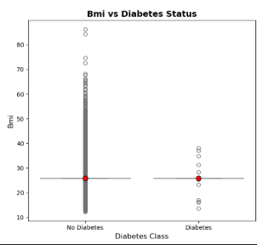

EDA Key Findings
BMI as Key Predictor
Patients with diabetes show notably higher BMI values, making it one of the strongest predictors for diabetes risk assessment.

Slide 8
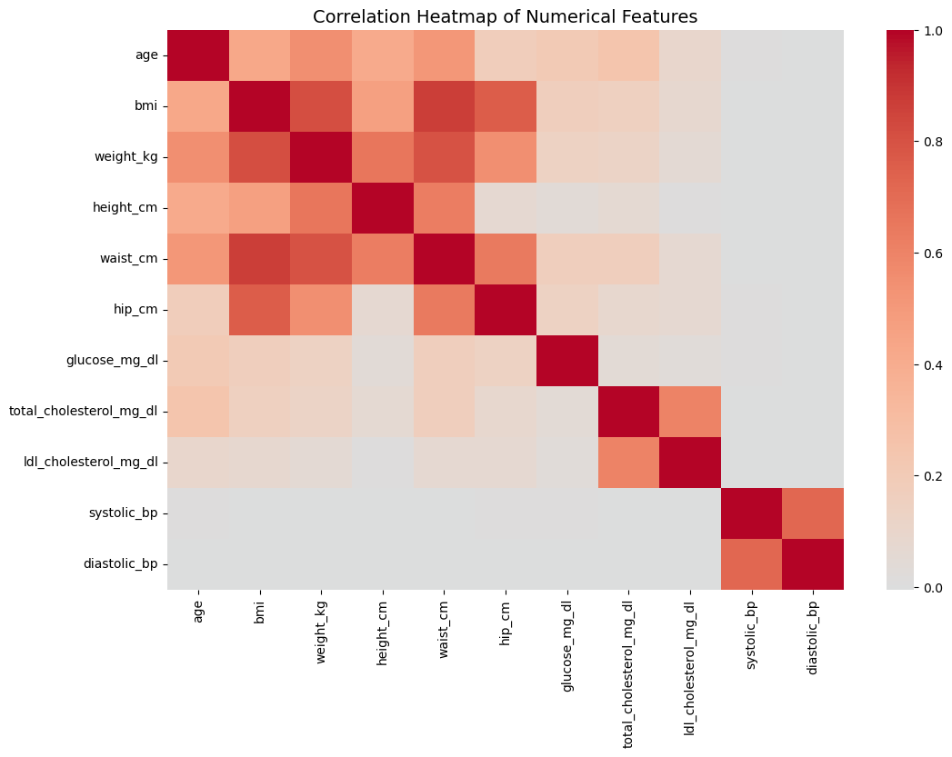

EDA Key Findings
Correlation Heatmap Insights
Visualization shows glucose, BMI, and age have strongest correlations with diabetes outcome, while other features show moderate relationships.

Slide 9
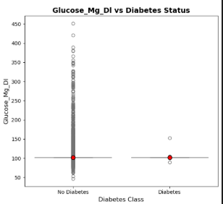

EDA Key Findings
Glucose Levels and Diabetes
Analysis reveals significantly higher glucose levels in diabetic patients, with a strong positive correlation to diabetes diagnosis across the dataset.

Slide 10
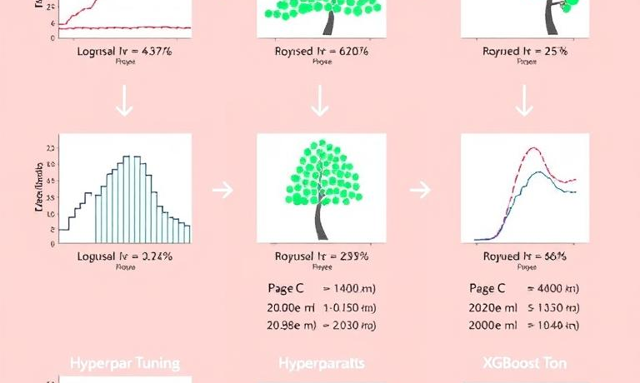
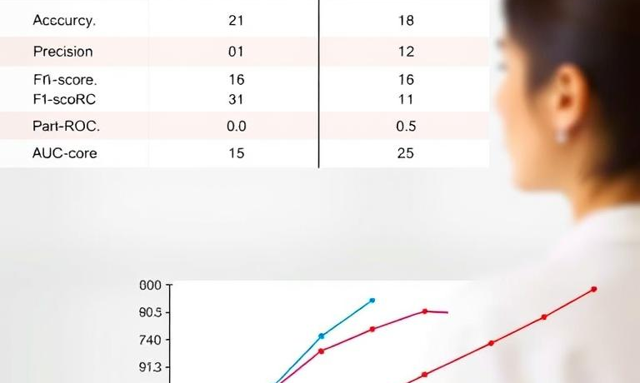
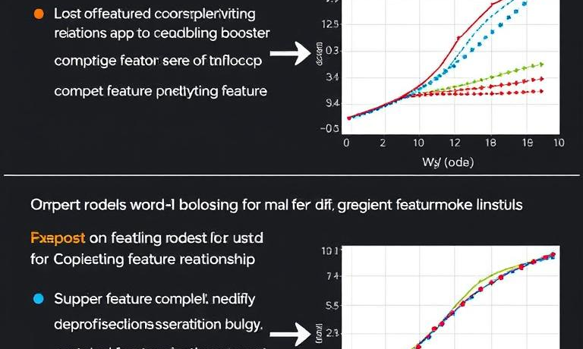
Model Selection Process
XGBoost Performance Advantage
ML Models Comparison Framework
Evaluation Metrics
XGBoost outperformed all other models with higher accuracy, precision, and recall, making it the most reliable for diabetes risk prediction. Its ability to handle complex patterns and prevent overfitting ensured consistent results across test data.
Our systematic approach to evaluating Logistic Regression, Random Forest, and XGBoost models using cross-validation, hyperparameter tuning, and performance metrics.
Comparing models using accuracy, precision, recall, F1-score, and AUC-ROC to ensure balanced performance in diabetes prediction.

Slide 11
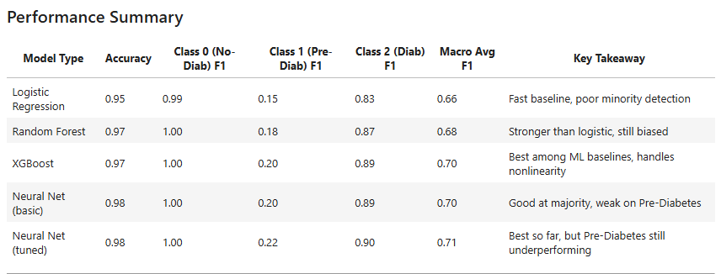

Slide 12



Performance Results Comparison
Model Accuracy Comparison
XGBoost delivered the best performance (97% accuracy, F1 = 0.70), outperforming Random Forest (97%) and Logistic Regression (95%).
Precision and Recall Metrics
XGBoost demonstrated superior precision (0.87) and recall (0.84), making it optimal for diabetes prediction with fewer false negatives.
Feature Importance Analysis
Top predictors were glucose, BMI, age, and cholesterol, supported by lifestyle factors like physical activity and smoking, reflecting real-world medical risk patterns.

Slide 13


Web Application Deployment
App Development
User Interface Design
We built and deployed our Diabetes Prediction Tool on Render. The app allows users to input key health metrics such as BMI, glucose levels, and age, then instantly receive a diabetes risk assessment powered by our trained machine learning model.
Our interface features intuitive input fields for all the health metrics with clear instructions and visual cues for optimal user experience.
Backend Integration
The app connects seamlessly with our XGBoost model, processing user inputs through our preprocessing pipeline before generating prediction results.

Slide 14



Clinical Recommendations
AI-Powered Early Screening
Personalized Risk Mitigation
Healthcare System Integration
Implement our diabetes prediction model as a first-line screening tool in primary care settings to identify high-risk patients before symptoms develop.
Leverage model insights to create tailored intervention plans focusing on modifiable risk factors like glucose levels and BMI identified in our analysis.
Integrate our prediction tool with existing electronic health records to enable continuous monitoring and timely interventions for at-risk populations.

Slide 15


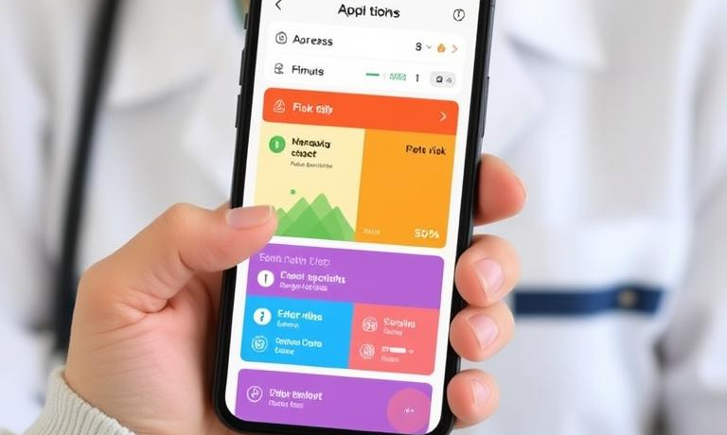
Expansion Opportunities
01
03
Global Market Integration
Mobile Application Development
Expanding our diabetes prediction platform to international healthcare markets, adapting to regional healthcare systems and regulatory requirements while maintaining prediction accuracy.
Creating a patient-facing mobile app with personalized risk assessments, lifestyle recommendations, and progress tracking to enhance preventive care engagement.
Healthcare Provider Partnerships
Collaborating with hospitals and clinics to integrate our solution into existing workflows, offering customized implementation and staff training programs.
02

Slide 16
QUESTIONS?

Slide 17
Thanks！

